Slide 1
Employee Data Analysis using Excel
STUDENT NAME: SWETHA.J
REGISTER NO: 312209461
DEPARTMENT: ACCOUNTING AND FINANCE B.COM
COLLEGE: ANNA ADARSH COLLEGE FOR WOMEN

Slide 2
PROJECT TITLE
Employee Performance Analysis using Excel

Slide 3


AGENDA
Problem Statement
Project Overview
End Users
Our Solution and Proposition
Dataset Description
Modelling Approach
Results and Discussion
Conclusion
3/21/2024 Annual Review

Slide 4

PROBLEM STATEMENT
The organization seeks to evaluate employee performance to identify high performers, areas needing improvement, and to align individual performance with organizational goals
The analysis aims to assess key performance metrics such as productivity, quality of work, attendance, and goal achievement across different departments and roles.
The key challenge is to accurately and efficiently organize, visualize, and interpret the performance data to support evidence-based decision-making.
This problem statement sets the stage for using Excel to gather, analyze, and visualize data for performance assessment, helping in making informed HR decisions.

Slide 5

PROJECT OVERVIEW
A detailed understanding of overall employee performance Identification of top performers and those needing improvement Insights into training needs and development opportunities Data-driven recommendations for enhancing employee productivity and engagement
This overview outlines the structured approach to conducting a comprehensive employee performance analysis using Excel, aiming to support continuous improvement in workforce management.

Slide 6

WHO ARE THE END USERS?
HR MANAGERS AND HR TEAMS
SENIOR MANAGEMENT AND EXECUTIVES
INDIVIDUAL EMPLOYEES
TEAM LEADERS
PERFORMANCE REVIEW COMMITTEES
PROJECT MANAGERS

Slide 7

OUR SOLUTION AND ITS VALUE PROPOSITION
HIGHTLIGHTS OF THE DATA
FILTERING-MISSING BLANKS ARE FILTERED
PIVOT TABLE-SUMMARY OF THE DATASET
CHARTS-BAR DIARGRAM AND PIE CHART OF THE DATASET
CONDITIONAL TECHNIQUES-IDENTIFICATION

Slide 8
Dataset Description
EMPLOYEE DATASET – KAGGLE
FEATURES-9
NAME-TEXT
EMPLOYEE ID
BUSINESS UNIT-TEXT
EMPLOYEE STATUS- TEXT
EMPLOYEE TYPE-TEXT
EMPLOYEE CLASSIFICATION- TEXT
GENDER CODE- MALE, FEMALE
PERFORMANCE SCORE- TEXT
CURRENT EMPLOYEE RATING-NUMERIC

Slide 9

THE "WOW" IN OUR SOLUTION
INTERACTIVE DASHBOARDS
PERFORMED HEAT MAPS
EMPLOYEE PERFORMANCE SCORECARDS
EMPLOYEE FEEDBACK INTEGRATION
3/21/2024 Annual Review
9

Slide 10
MODELLING
*Data Import and Preparation:* Import data from various sources like HR databases, performance reviews, and attendance logs. Clean and organize the data in a structured format (e.g., tables) for easy analysis. - *Data Normalization:* Standardize data to ensure consistency, such as converting performance scores to a common scale or handling missing values.
2. *Defining Key Performance Indicators (KPIs):* - Identify the KPIs relevant to employee performance, such as productivity, quality of work, punctuality, and goal achievement. Modeling involves calculating these KPIs from raw data using Excel formulas and functions.
3. *Developing Calculation Models:* - Use Excel formulas, functions (like VLOOKUP, IF, SUMIFS), and statistical tools (like AVERAGE, STDEV) to create calculation models that evaluate performance metrics. - For example, you might create a formula to calculate an overall performance score by weighting different KPIs based on their importance.
4. *Creating Performance Scorecards:* - Develop scorecards or performance models that compile multiple metrics into a single view. This might involve creating a composite score that combines different KPIs into one overall performance rating.
5. *Scenario and Predictive Modeling:* - Use Excel’s scenario analysis tools (like What-If Analysis, Data Tables, Goal Seek) to model different performance scenarios or predict future performance trends based on historical data.
10

Slide 11
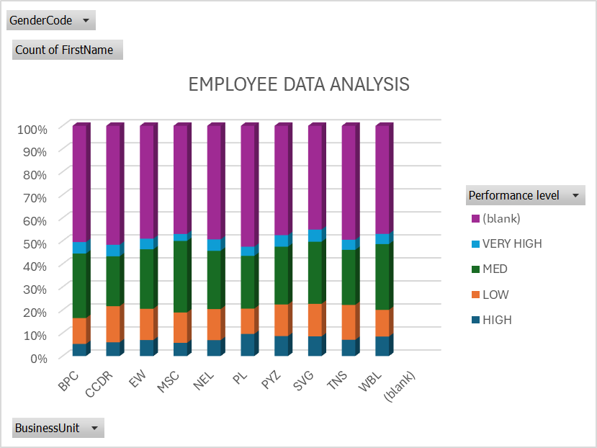
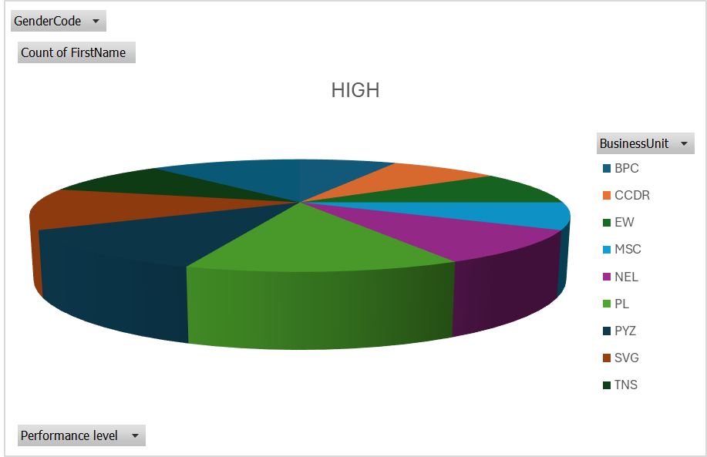
RESULTS
11

Slide 12
conclusion
SUMMARY OF KEY FINDINGS
BENEFITS OF USING EXCEL
RECOMMENDATIONS
LIMITATIONS
OVERALL IMPACT
INSIGHTS AND IMPLICATIONS

